Slide 1
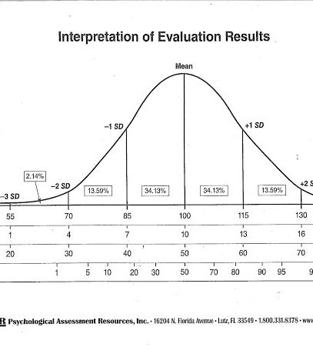
BASIC STATISTICS

Slide 2
Revision

Slide 3
COURSE AGENDA
Basic Statistics & Hypothesis Testing
Data Mining- Supervised & Unsupervised
Text Mining/ NLP
Data Visualization using Tableau
Forecasting

Slide 4
DATATYPES
QUANTITATIVE
QUALITATIVE
“The sky is beautiful today”
“This towel is so soft”
CONTINUOUS
DISCRETE

Slide 5
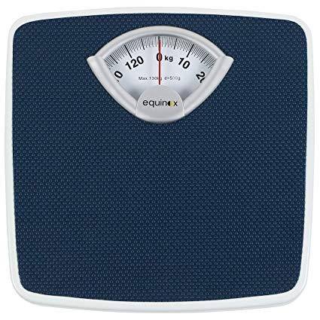
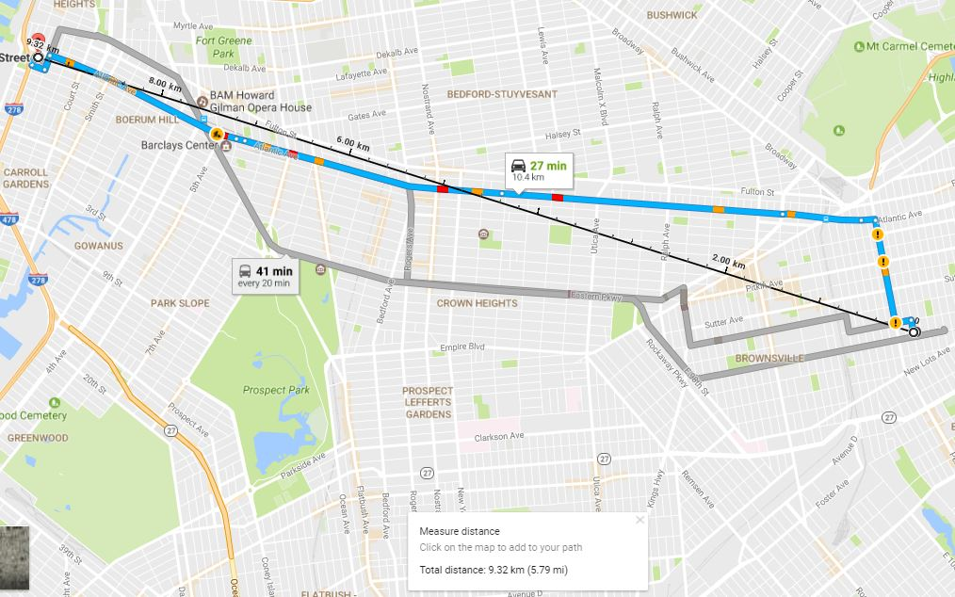

DATA TYPES- Continuous

Slide 6


DATA TYPES- Discrete

Slide 7
Data & Measurement Scales- Preliminaries
Nominal – Merely labels. No further information can be gleaned.
E.g.: Coke and Pepsi; Honda and Toyota
Ordinal – Conveys Preference Information alone.
E.g.: I prefer Honda Activa over TVS Jupiter
Interval – Conveys relative magnitude information in addition to preference
E.g.: Ratings
Ratio – Conveys information on an absolute scale.
E.g.: Money Paid

Slide 8
Statistical Analysis of Data Types
NOMINAL | ORDINAL | INTERVAL | RATIO
Mode | Mode | Mode | Mode
Frequencies | Median | Median | Median
Percentages | Frequencies | Mean | Mean
Few Statistical Analysis | Percentages | Frequencies | Frequencies
 | Some Statistical Analysis | Percentages | Percentages
 |  | Variance | Variance
 |  | Standard Deviation | Standard Deviation
 |  | Most Statistical Analysis | Ratio of Numbers
 |  |  | All Statistical Analysis

Slide 9


Random Variable
A Random Variable describes the probabilities from uncertain future numerical outcome of a random process
It’s variable because it can take one of several possible values.
It’s random because there is some chance associated with each possible value.

Slide 10

Probability
$$Probability=\frac{Interested Events}{Total Number of Events}$$

Slide 11
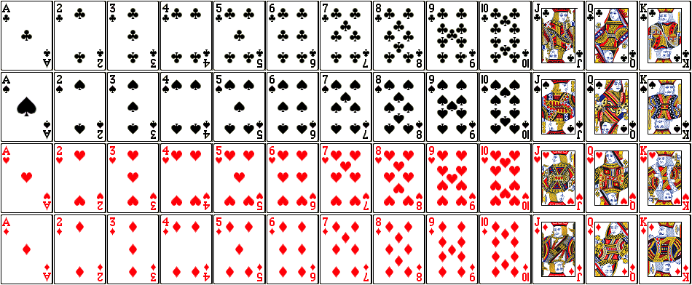
From the Deck of cards:
What is the probability of drawing a heart?
What is the probability of drawing a three?
What is the probability of drawing a card greater than 10?
What is the probability of drawing a card greater than 3, less than 8?

Slide 12
Probability Distribution
A Probability Distribution is a table or an equation that links each outcome of a statistical experiment with its probability of occurrence.
Consider the table:
Number of Phone sales (x) | Probability(X=x)
0 | 0.25
1 | 0.50
2 | 0.25
3 | 0.50
What is the probability of a sale?
What is the probability of at least two sales?

Slide 13
Probability Distribution
Continuous
Discrete

Slide 14
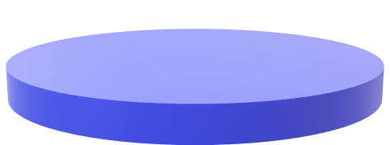

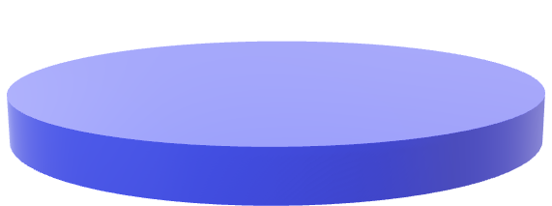
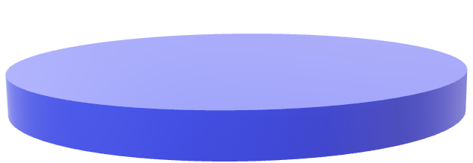
Sampling Funnel
POPULATION SAMPLE
FRAMING SAMPLE
SRS
SAMPLE

Slide 15
EXPLORATORY DATA ANALYSIS

Slide 16
Collect the data and the domain knowledge
Confirm datatypes and probabilities
Measures of Central tendency
Measures of Dispersion
Skewness and Kurtosis
Graphical Representation

Slide 17
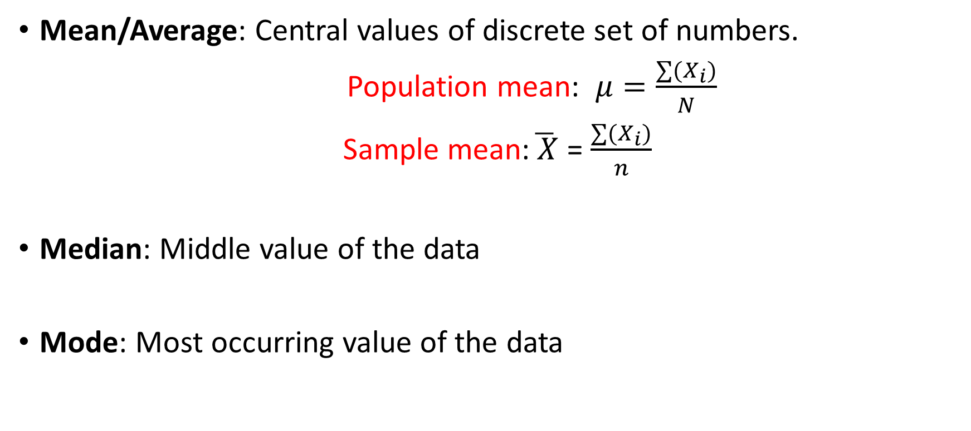
Measures of Central Tendency
Mean/Average: Central values of discrete set of numbers.
Population mean: $μ=\frac{∑(X_{i})}{N}$
Sample mean:$\overline{ X}$ = $\frac{∑(X_{i})}{n}$
Median: Middle value of the data
Mode: Most occurring value of the data

Slide 18

Measures of Dispersion
MACHINE A
MACHINE B
USL= 229mm
$$\overline{X}$$
LSL =224mm
Dispersion is defined as the distance between the data point to the average

Slide 19
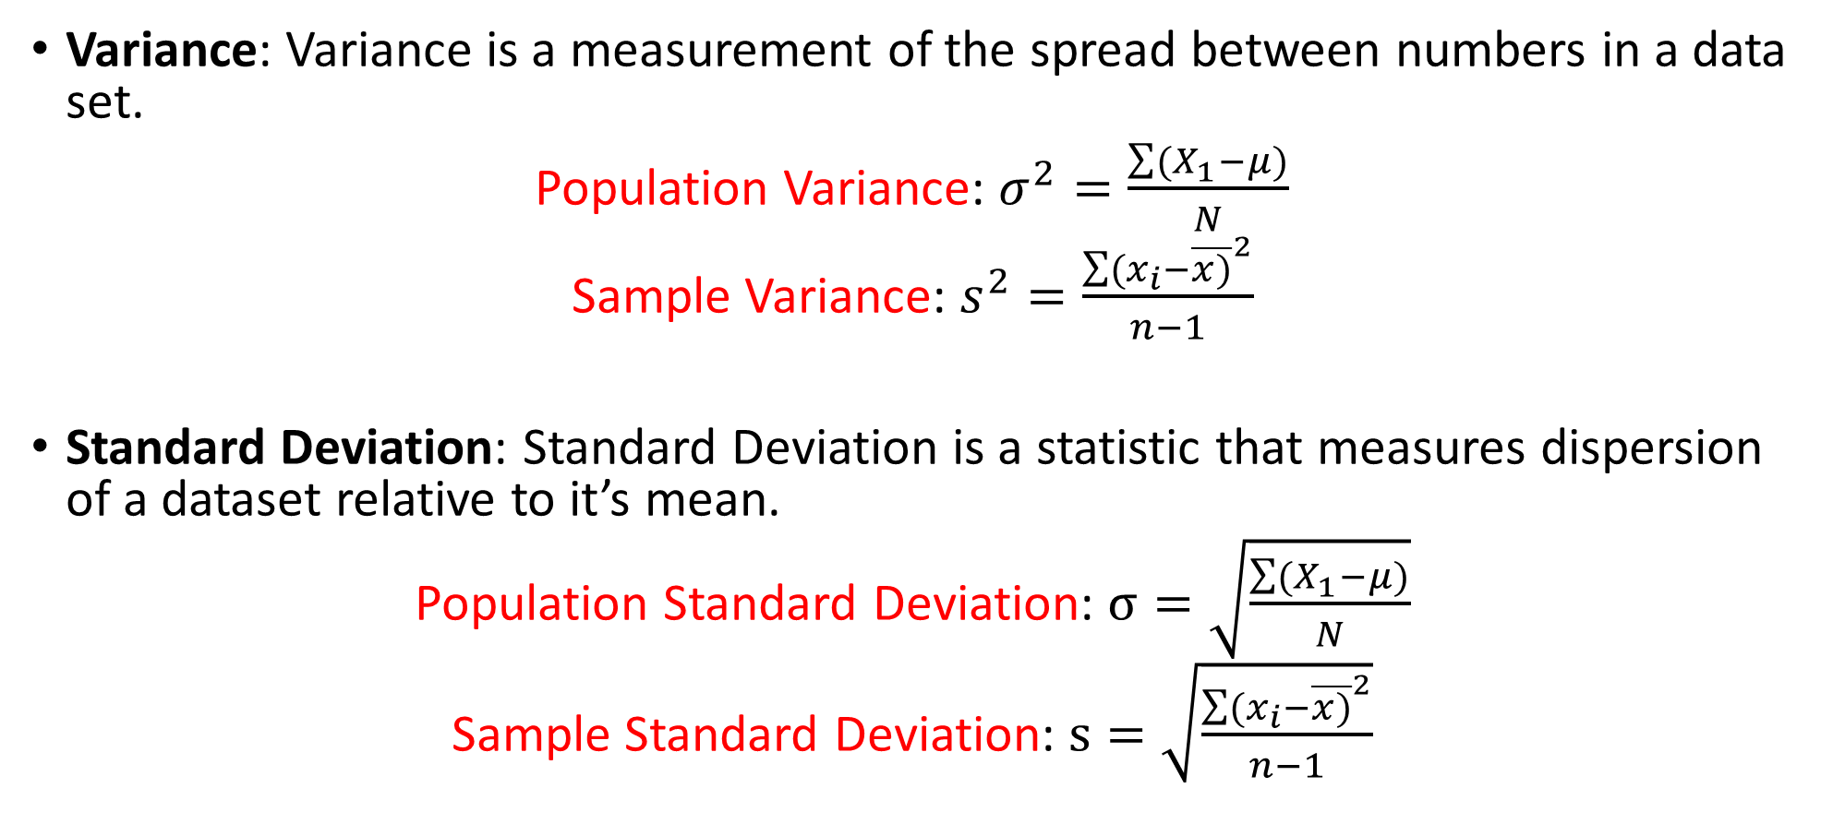
Measures of Dispersion
Variance: Variance is a measurement of the spread between numbers in a data set.
Population Variance: $σ^{2}=\frac{\sum{(X_{1}−μ)}}{N}$
Sample Variance: $s^{2}=\frac{{\sum{(x_{i}−\overline{x)}}}^{2}}{n−1}$
Standard Deviation: Standard Deviation is a statistic that measures dispersion of a dataset relative to it’s mean.
Population Standard Deviation: $σ=\sqrt{\frac{\sum{(X_{1}−μ)}}{N}}$
Sample Standard Deviation: $s=\sqrt{\frac{{\sum{(x_{i}−\overline{x)}}}^{2}}{n−1}}$

Slide 20

Measures of Dispersion
Range: The difference between lowest and highest values.
$$Range= Max−Min$$

Slide 21
Expected Value
For a probability distribution, the mean of the distribution is known as “Expected Value”.
The expected value intuitively refers to what one would find if they repeated the experiment an infinite number of times and took the average of all of the outcomes.
Mathematically, it’s calculated as a weighted average of each possible value.

Slide 22
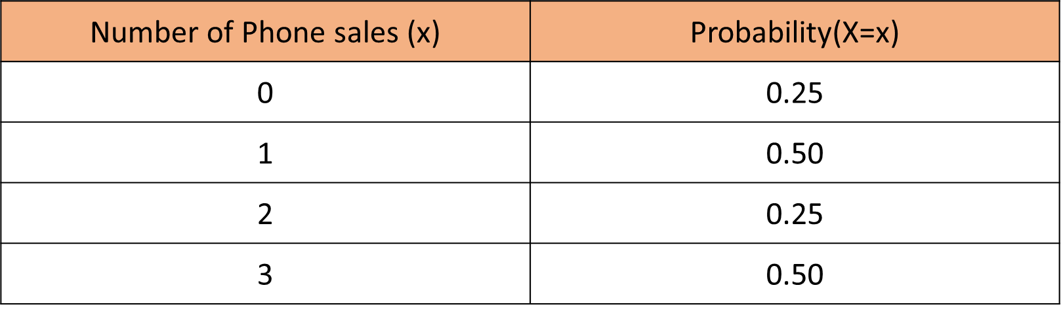
Expected Value

Slide 23
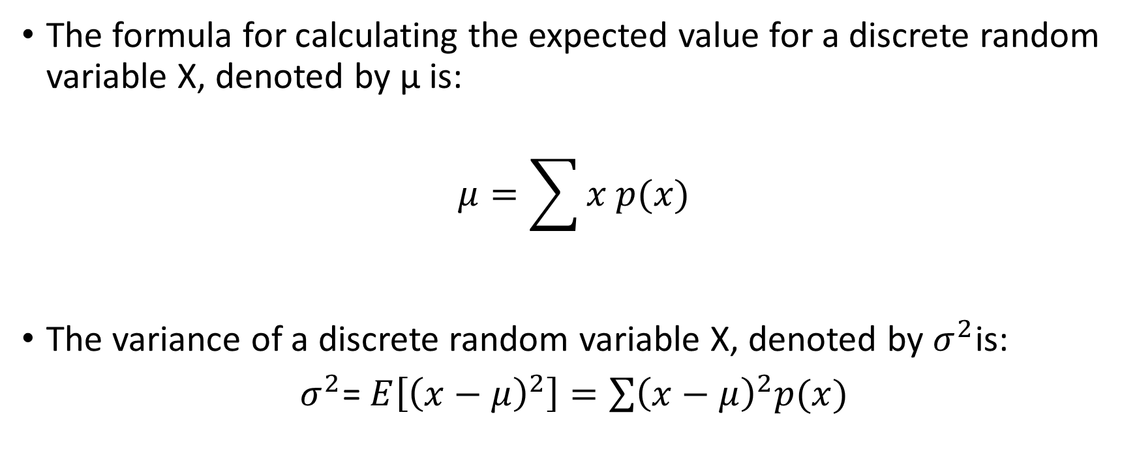
Expected Value
The formula for calculating the expected value for a discrete random variable X, denoted by µ is:
$$μ=\sum{x p(x)}$$
The variance of a discrete random variable X, denoted by $σ^{2}$is:
$σ^{2}$= $E\left[{\left(x−μ\right)}^{2}\right]=\sum{{\left(x−μ\right)}^{2}p(x)}$

Slide 24
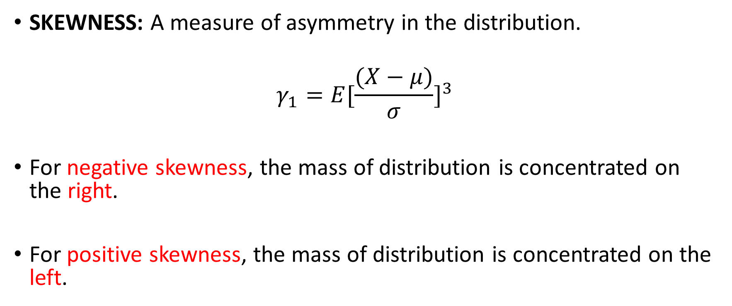
Third Moment Business Decision
SKEWNESS: A measure of asymmetry in the distribution.
$$γ_{1}=E{[\frac{(X−μ)}{σ}]}^{3}$$
For negative skewness, the mass of distribution is concentrated on the right.
For positive skewness, the mass of distribution is concentrated on the left.

Slide 25
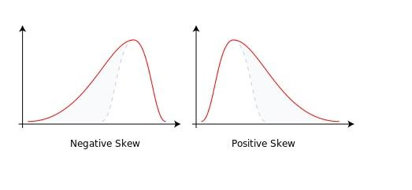
Skewness

Slide 26
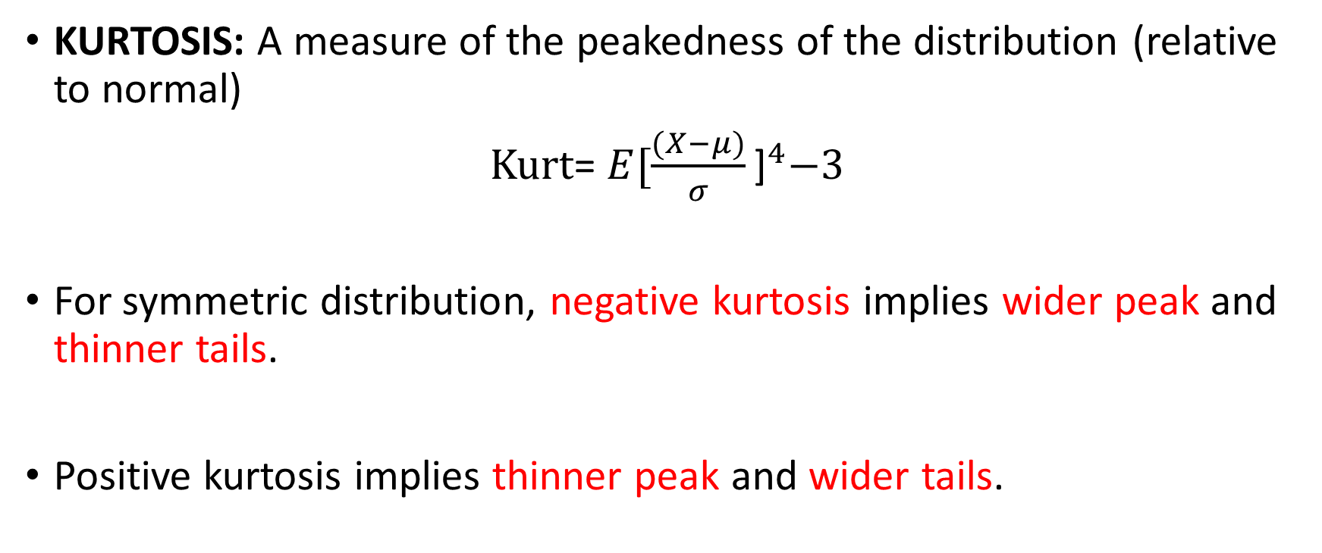
Fourth Moment Business Decision
KURTOSIS: A measure of the peakedness of the distribution (relative to normal)
Kurt= $E{[\frac{(X−μ)}{σ}\text{]}}^{4}−3$
For symmetric distribution, negative kurtosis implies wider peak and thinner tails.
Positive kurtosis implies thinner peak and wider tails.

Slide 27
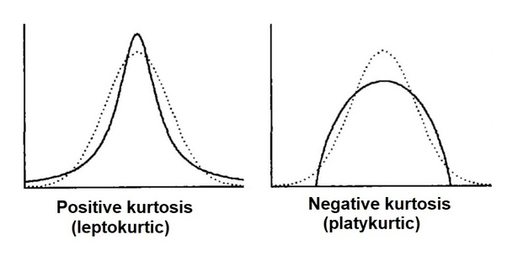
Kurtosis

Slide 28
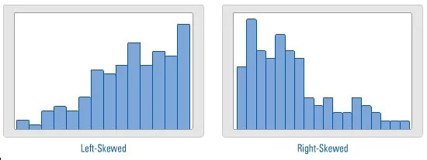
Real-time Examples

Slide 29
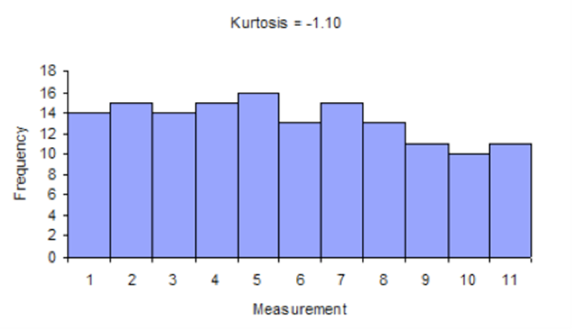
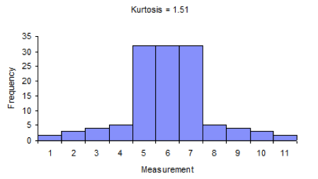
Real-time Examples

Slide 30

Introduction to R

Slide 31
Programming language and free software environment for statistical computing and graphics.
Supported by the R Foundation for Statistical Computing.
Interpreted language
Supports matrix arithmetic.
The capabilities of R are extended through user-created packages, which allow specialized statistical techniques, graphical devices, import/export capabilities, reporting tools, etc.

Slide 32

GRAPHICAL REPRESENTATIONS

Slide 33
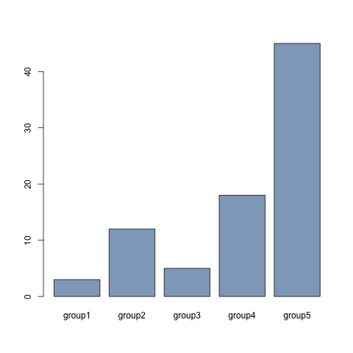
Bar Graph
A bar chart presents categorical data with rectangular bars with heights or lengths proportional to the values that they represent.

Slide 34
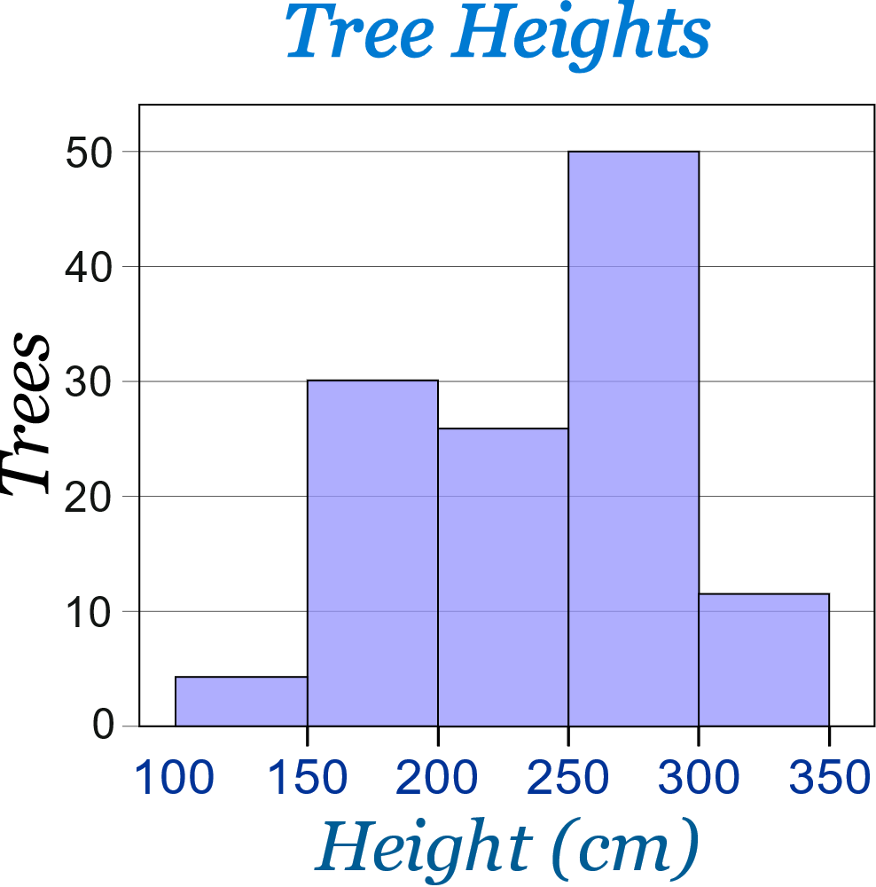
Histogram
A histogram represents the frequency distribution i.e., how many observations take the value to a certain level.

Slide 35
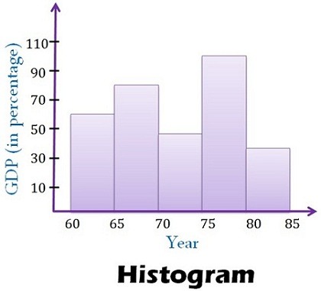
Histogram

Slide 36
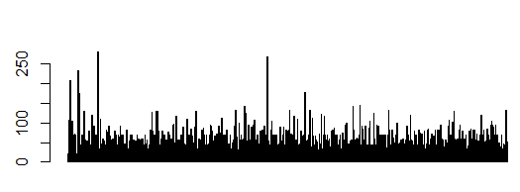
Histogram v/s Bar plot

Slide 37
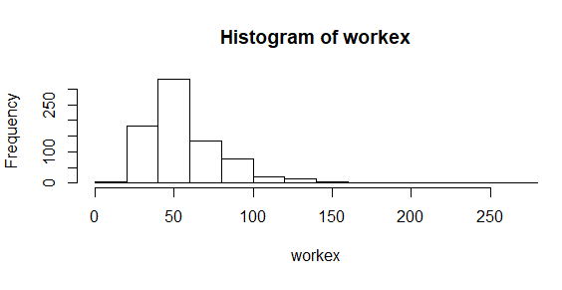
Histogram v/s Bar plot

Slide 38
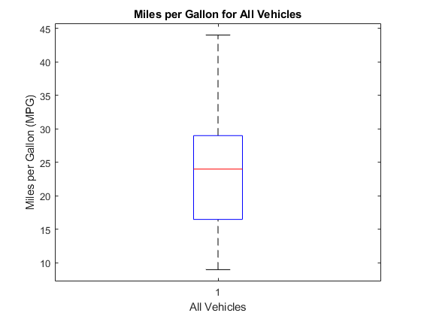
Boxplot
Outlier
Upper Extreme
Q3+1.5(IQR)
Upper Quartile
Median
Lower Quartile
Whisker
IQR
(Interquartile Range)
Q1-1.5(IQR)
Lower Extreme
A box plot or box and whisker plot is a method for graphically depicting groups of numerical data through their quartiles.

Slide 39
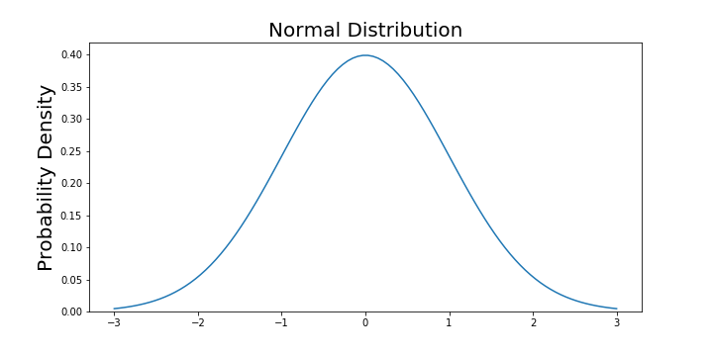
Normal Distribution
The normal distribution is a probability function that describes how the values of a variable are distributed.

Slide 40

Normal Distribution Properties
The normal random variable takes values from $−∞$to $+∞.$
The probability associated with any single value of a random variable is always 0.
Area under entire curve is always 1.

Slide 41
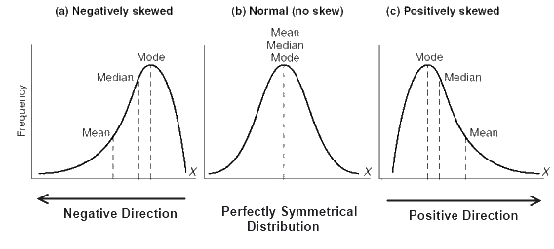
Normal Distribution

Slide 42
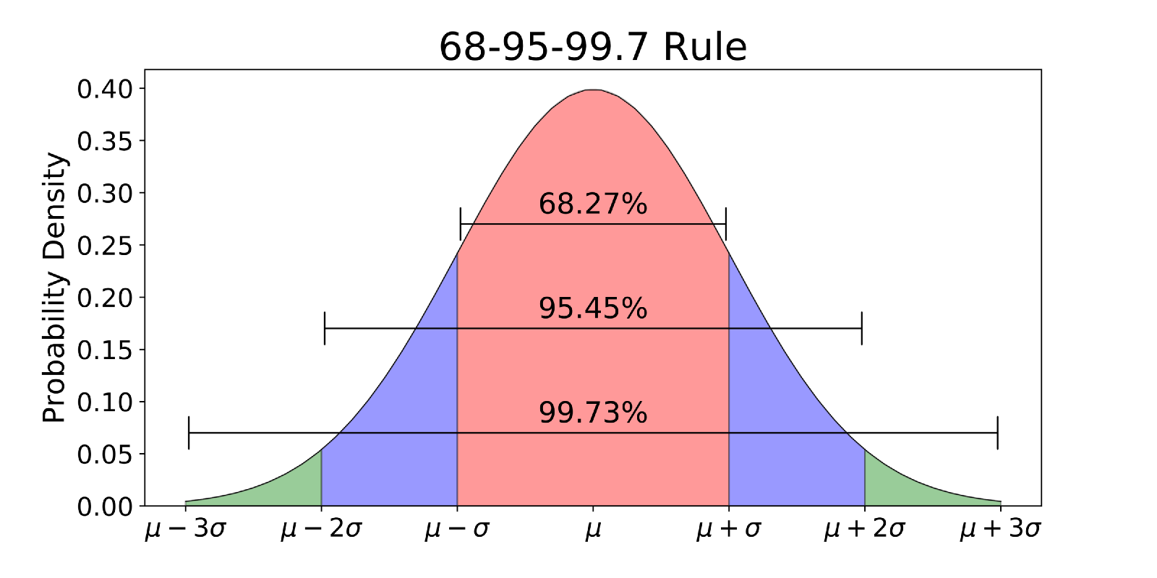
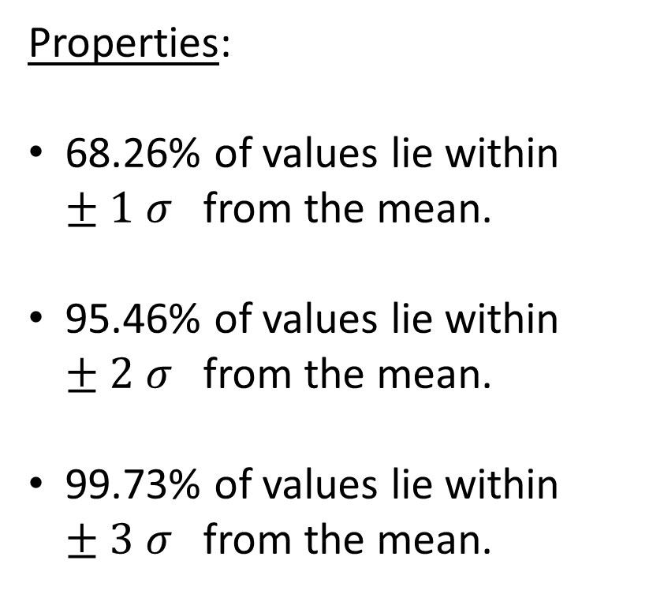
Normal Distribution
Properties:
68.26% of values lie within $±1 σ$from the mean.
95.46% of values lie within $±2 σ$from the mean.
99.73% of values lie within $±3 σ$from the mean.

Slide 43
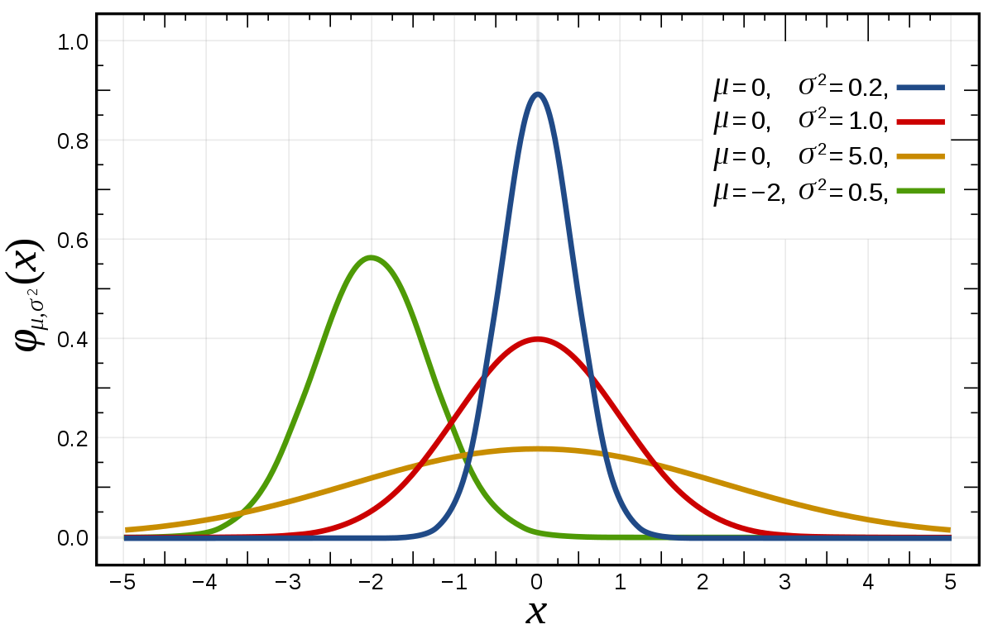
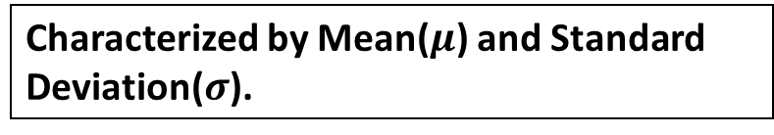
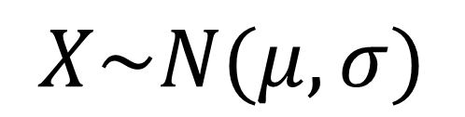
Normal Distribution- Probability Distribution Function
Characterized by Mean($μ$) and Standard Deviation($σ$).
$$X\sim N(μ,σ)$$

Slide 44
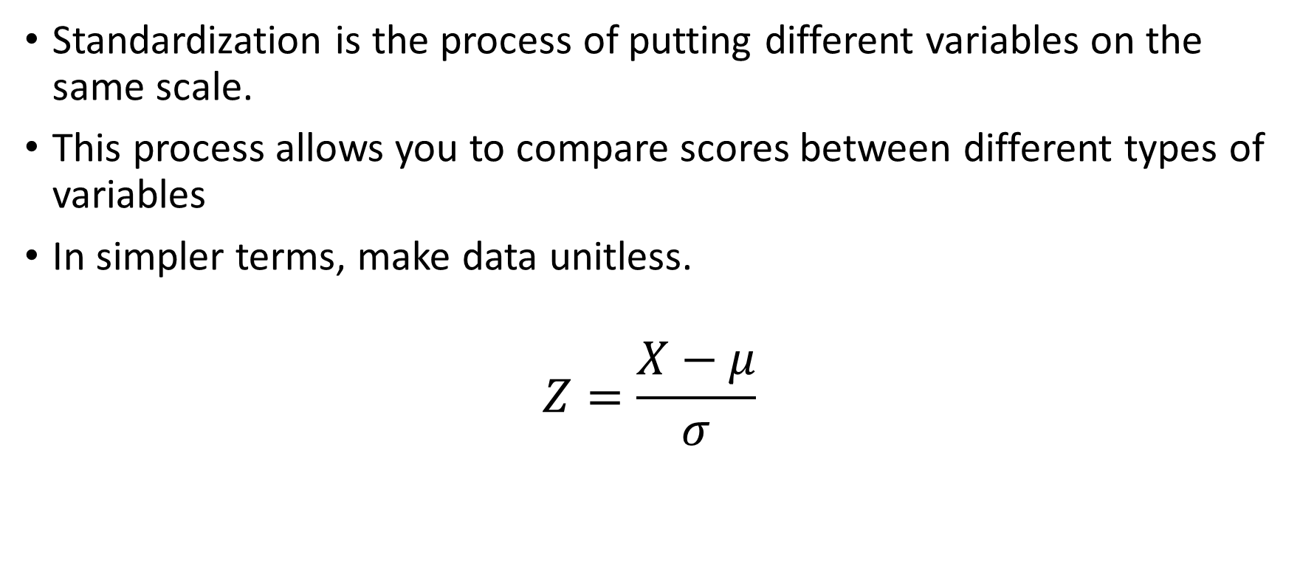
Standard Normal Distribution
Standardization is the process of putting different variables on the same scale.
This process allows you to compare scores between different types of variables
In simpler terms, make data unitless.
$$Z=\frac{X−μ}{σ}$$

Slide 45
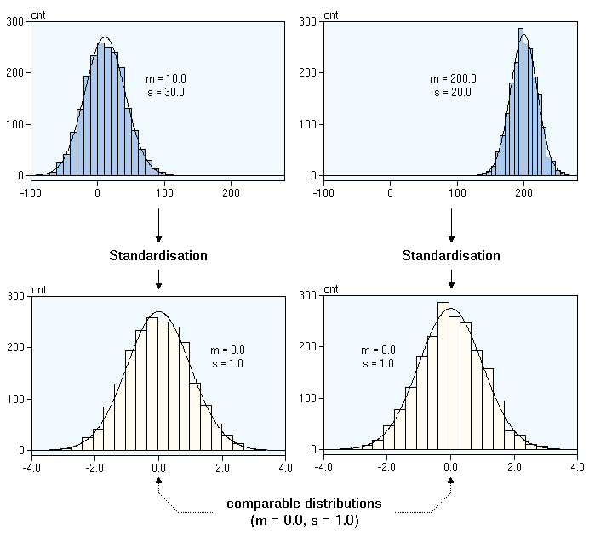
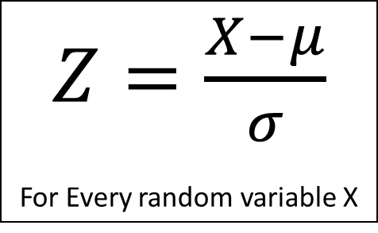
Z-Score
A Z-score is the number of standard deviations from the mean a data point is.
$Z=\frac{X−μ}{σ}$
For Every random variable X

Slide 46
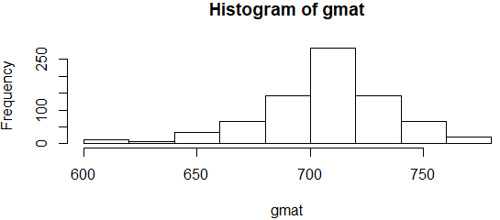
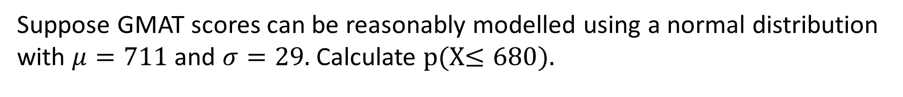
Calculating Probability from Z-distribution
Suppose GMAT scores can be reasonably modelled using a normal distribution with $μ=711$and $σ=29.$Calculate p(X$≤680)$.
1→ Calculate Z-score corresponding to 680.
Z= (680-711)/29= -1.06
2→ Calculate probabilities using Z-tables.
P(Z-1)=0.14

Slide 47
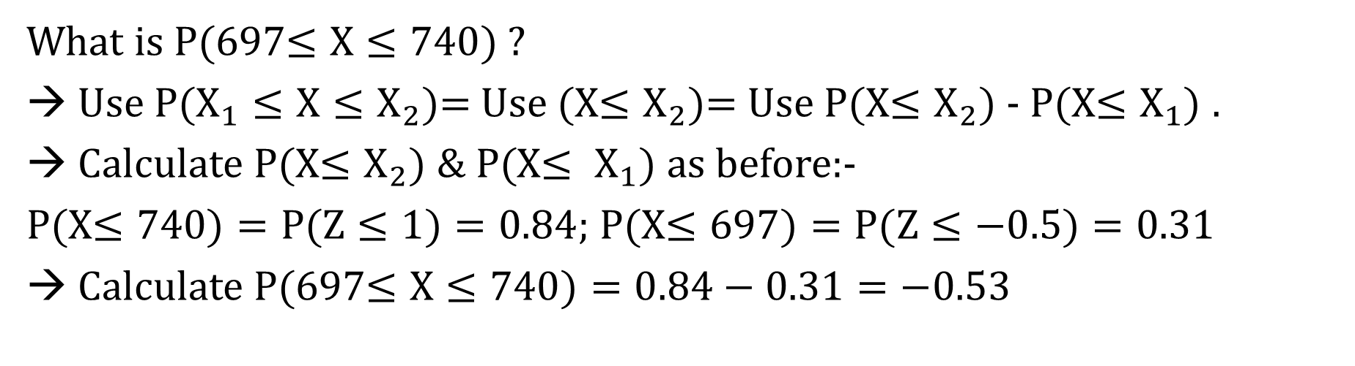
Calculating Probability from Z-distribution
What is P(697$≤X≤740)$?
→ Use P($X_{1}≤X≤X_{2}$)= Use (X$≤X_{2})$= Use P(X$≤X_{2})$ - P(X$≤X_{1})$ .
Calculate P(X$≤X_{2}) \& P($X$≤ X_{1}$) as before:-
P(X$≤740)=P(Z≤1)=0.84$; P(X$≤697)=P(Z≤−0.5)=0.31$
→ Calculate P(697$≤X≤740)=0.84−0.31=−0.53$

Slide 48
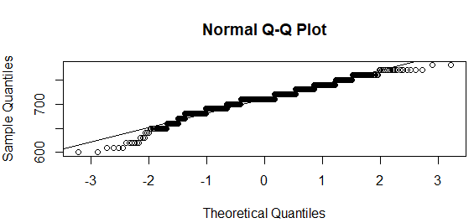
Normal Quantile Plot

Slide 49
Sampling Variation
Sample mean varies from one sample to another.
Sample mean can & most likely will be different from the population mean.
Sample mean is a random variable.
Sample-size 2
Sample mean
Probability
Population
(26,32)
29
1/6
(26,32,34,40)
(26,34)
30
1/6
(26,40)
33
1/6
(32,34)
33
1/6
(32,40)
36
1/6
(34,40)
37
1/6

Slide 50
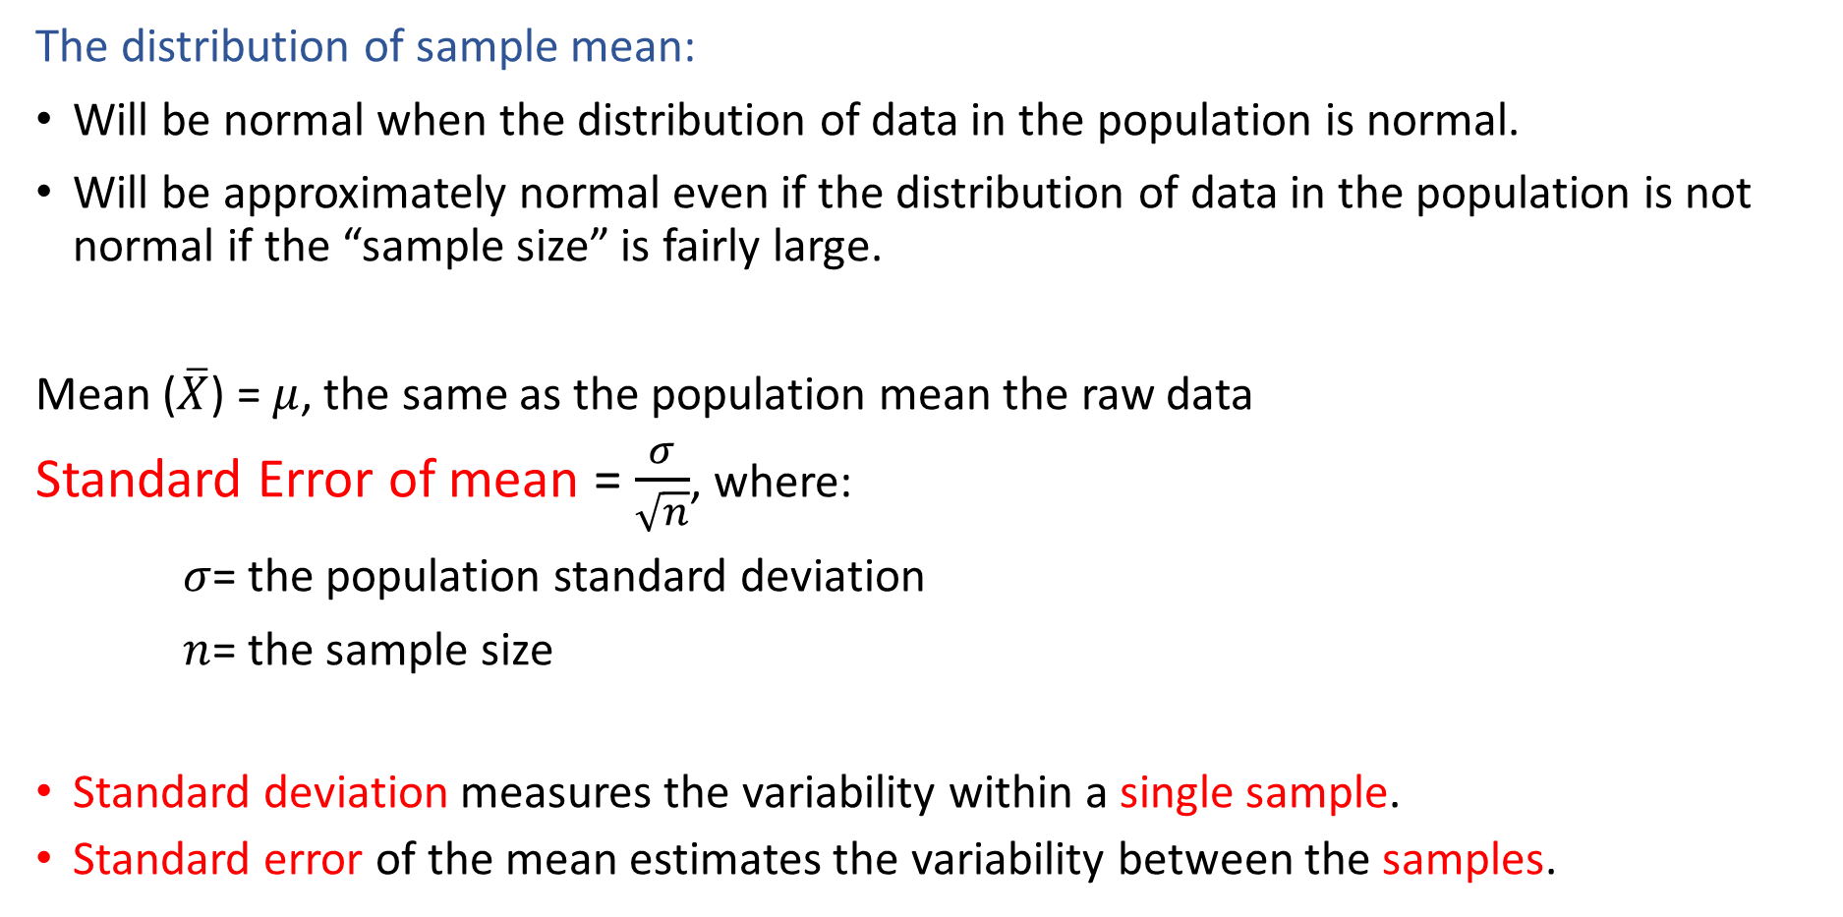
Central Limit Theorem
The distribution of sample mean:
Will be normal when the distribution of data in the population is normal.
Will be approximately normal even if the distribution of data in the population is not normal if the “sample size” is fairly large.
Mean ($\overline{X}$) = $μ$, the same as the population mean the raw data
Standard Error of mean = $\frac{σ}{\sqrt{n}}$, where:
$σ$= the population standard deviation
$n$= the sample size
Standard deviation measures the variability within a single sample.
Standard error of the mean estimates the variability between the samples.

Slide 51
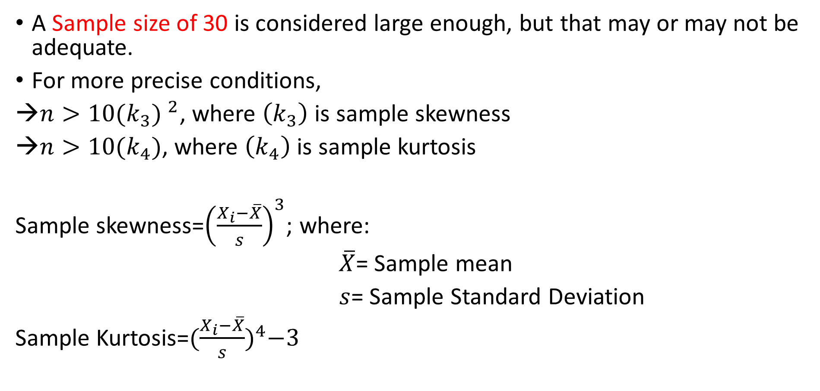
Sample Size Calculation
A Sample size of 30 is considered large enough, but that may or may not be adequate.
For more precise conditions,
$n>10{(k_{3}) }^{2}$, where $\left(k_{3}\right)$ is sample skewness
$n>10(k_{4})$, where $\left(k_{4}\right)$ is sample kurtosis
Sample skewness=${\left(\frac{X_{i}−\overline{X}}{s}\right)}^{3}$; where:
$\overline{X}$= Sample mean
$s$= Sample Standard Deviation
Sample Kurtosis=${(\frac{X_{i}−\overline{X}}{s})}^{4}−3$

Slide 52

Confidence Interval $(1−α)$
What is the probability of tomorrow’s temperature being 42 degrees?
A: The probability is ‘0’; as the probability of a point estimate is 0.
The range of values known as Interval Estimate.
Can’t be between [-50 & 100] degree Celsius?

Slide 53

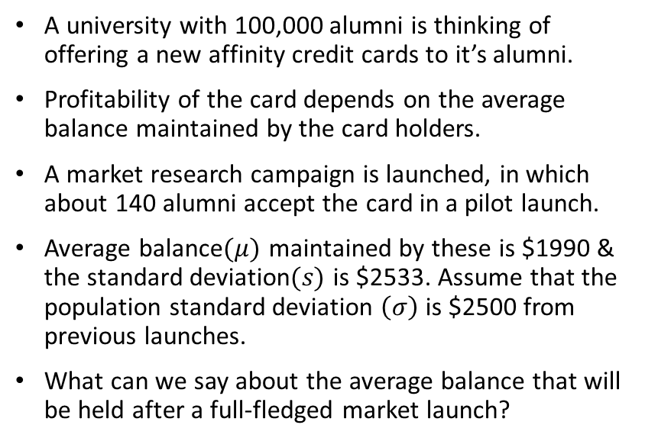
Confidence Interval: Case Study
A university with 100,000 alumni is thinking of offering a new affinity credit cards to it’s alumni.
Profitability of the card depends on the average balance maintained by the card holders.
A market research campaign is launched, in which about 140 alumni accept the card in a pilot launch.
Average balance$(μ)$ maintained by these is $1990 & the standard deviation$(s)$ is $2533. Assume that the population standard deviation $\left(σ\right)$ is $2500 from previous launches.
What can we say about the average balance that will be held after a full-fledged market launch?

Slide 54
Confidence Interval : Case Study
Scenario A: Launch credit card to entire population and stop if loss is recorded.
Scenario B: Do a pilot launch, stop if loss is recorded, if profitable, launch to the population.

Slide 55
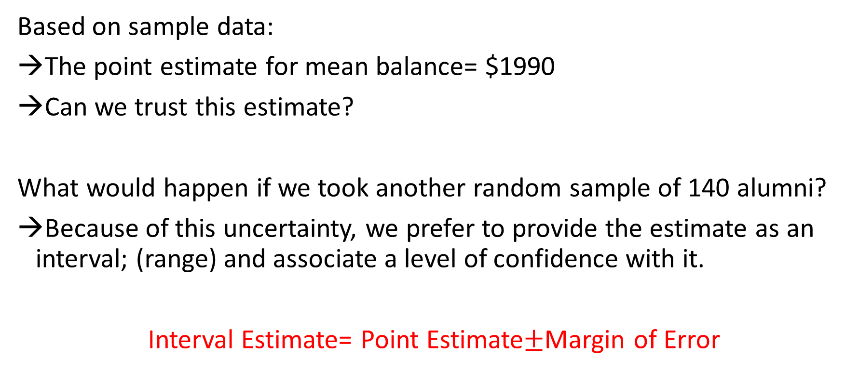
Interval Estimates of Sample data
Based on sample data:
The point estimate for mean balance= $1990
Can we trust this estimate?
What would happen if we took another random sample of 140 alumni?
Because of this uncertainty, we prefer to provide the estimate as an interval; (range) and associate a level of confidence with it.
Interval Estimate= Point Estimate$±$Margin of Error

Slide 56
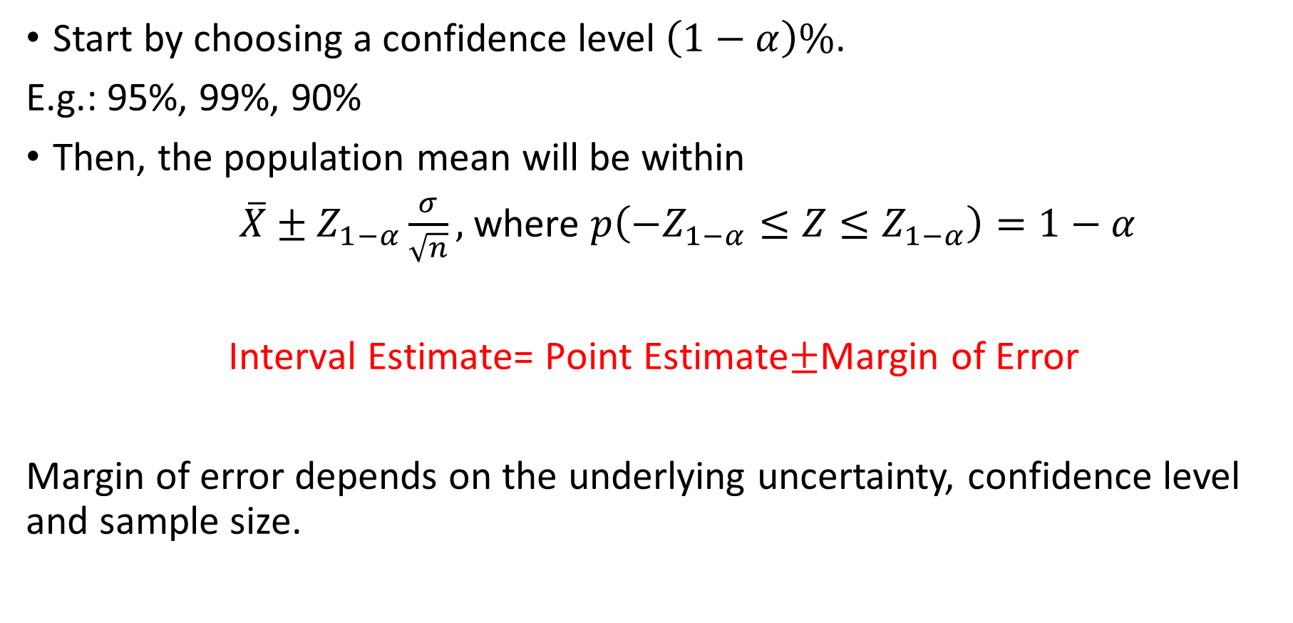
Confidence Interval for the Population mean
Start by choosing a confidence level $\left(1−α\right)\%$.
E.g.: 95%, 99%, 90%
Then, the population mean will be within
$\overline{X}±Z_{1−α}\frac{σ}{\sqrt{n}},$where $p\left(−Z_{1−α}≤Z≤Z_{1−α}\right)=1−α$
Interval Estimate= Point Estimate$±$Margin of Error
Margin of error depends on the underlying uncertainty, confidence level and sample size.

Slide 57
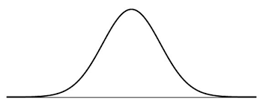
Calculate Z-value: 90%, 95% & 99%

Slide 58
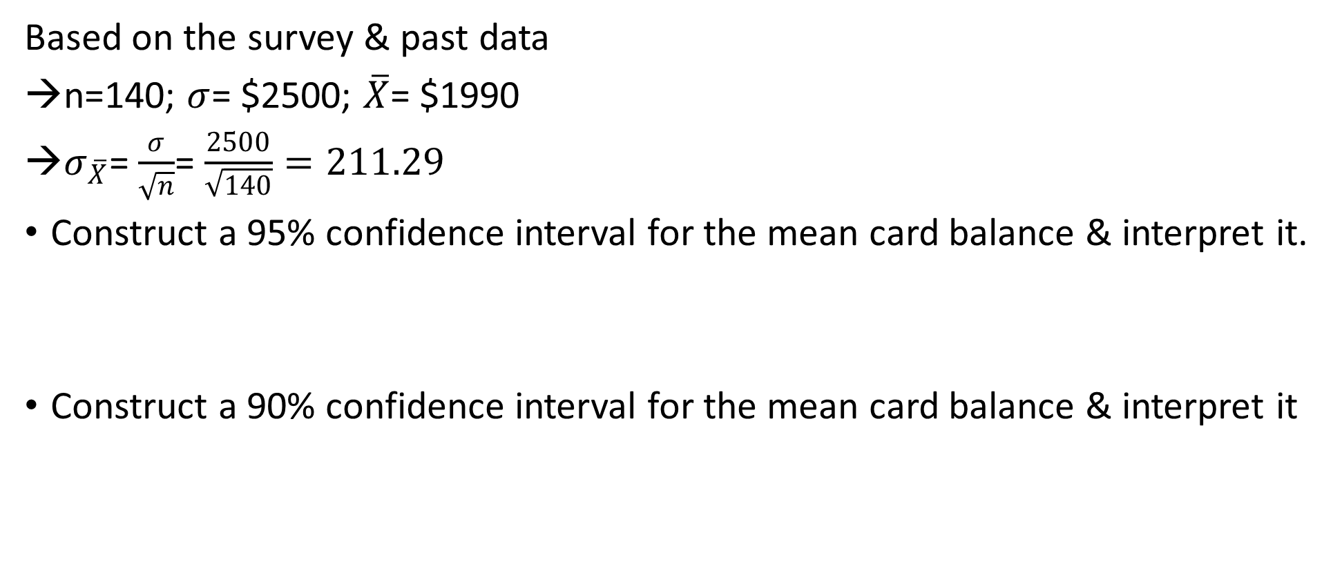
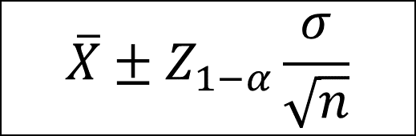
Confidence Interval Calculation
Based on the survey & past data
n=140; $σ$= $2500; $\overline{X}$= $1990
$σ_{\overline{X}}$= $\frac{σ}{\sqrt{n}}$= $\frac{2500}{\sqrt{140}}=211.29$
Construct a 95% confidence interval for the mean card balance & interpret it.
Construct a 90% confidence interval for the mean card balance & interpret it
$$\overline{X}±Z_{1−α}\frac{σ}{\sqrt{n}}$$

Slide 59
Confidence Interval Interpretation
Consider the 95% confidence interval for the mean income: [$1576,$2404].
Does this mean that:
The mean balance of the population lies in the range?
The mean balance is this range 95% of this time?
95% of the alumni have balance is the range?
Interpretation1: Mean of the population has a 95% chance of being in this range for a random sample.
Interpretation2: Mean of the population will be this range for 95% of the random samples

Slide 60
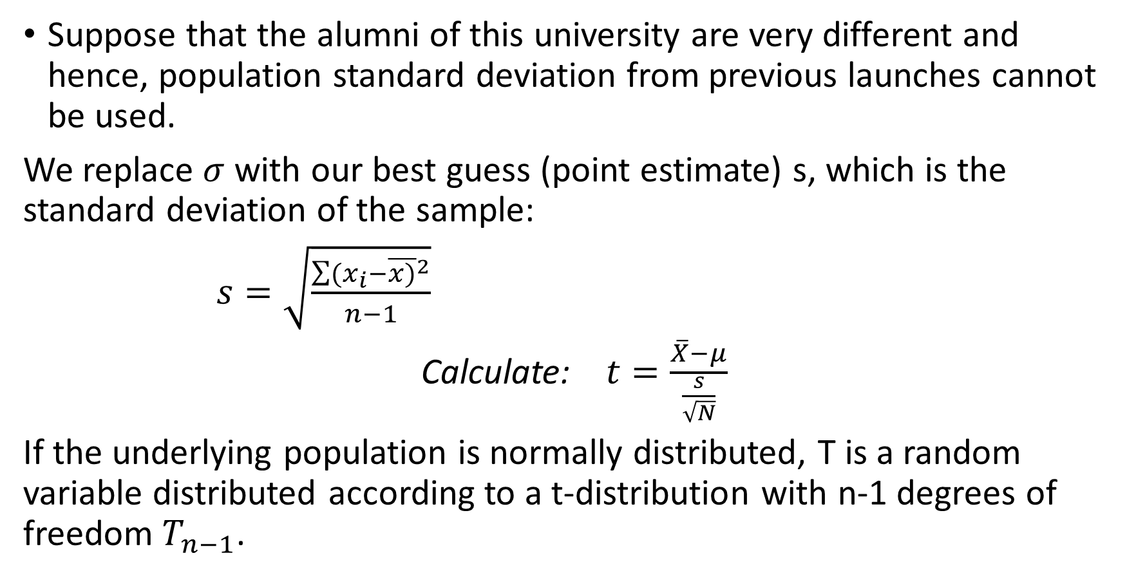
What if we don’t know Sigma?
Suppose that the alumni of this university are very different and hence, population standard deviation from previous launches cannot be used.
We replace $σ$ with our best guess (point estimate) s, which is the standard deviation of the sample:
$s=\sqrt{\frac{\sum{{(x_{i}−\overline{x)}}^{2}}}{n−1}}$
Calculate: $t=\frac{\overline{X}−μ}{\frac{s}{\sqrt{N}}}$
If the underlying population is normally distributed, T is a random variable distributed according to a t-distribution with n-1 degrees of freedom $T_{n−1}$.

Slide 61


Student’s t-distribution
As $n→ ∞$, $t_{n}→N(0,1)$ i.e., as the degrees of the freedom increase, the t-distribution approaches the standard normal distribution.

Slide 62

Confidence Interval for mean with unknown Sigma
$\overline{X}±Z_{1−α}\frac{σ}{\sqrt{n}},$where $Z_{1−α} satisfies p\left(−Z_{1−α}≤Z≤Z_{1−α}\right)=1−α$
$\overline{X}±$ $t_{1−α,n−1}\frac{s}{\sqrt{n}},$where${ t}_{1−α,n−1} satisfies p\left(−t_{1−α}≤t≤t_{1−α}\right)=1−α$

Slide 63


Calculating t-value
n=140; $s$=$2533; $\overline{X}$= $1990
$σ_{X}= \frac{2533}{\sqrt{140}}$= 214.11
Calculate $t_{0.95,139}=1.98$
Then, the 95% Confidence Interval for balance is [$1566, $2413].
$\overline{X}±$ $t_{1−α,n−1}\frac{s}{\sqrt{n}}$

Slide 64
NEXT TOPIC> HYPOTHESIS TESTING & REGRESSION ANALYSIS

